Slide 1

Chapter 15: Monetary Policy
© 2014 Cengage Learning. All Rights Reserved. May not be copied, scanned, or duplicated, in whole or in part, except for use as permitted in a license distributed with certain product , service, or otherwise on password-protected website for classroom use

Slide 2

In This Lecture…..
The Keynesian Transmission Mechanism
The Monetarist Transmission Mechanism
Bond Prices and Interest Rates
The Activist-Non-activist Debate
Non-activist (or Rules-Based) Monetary Proposals
To select a topic, click on its link above
© 2014 Cengage Learning. All Rights Reserved. May not be copied, scanned, or duplicated, in whole or in part, except for use as permitted in a license distributed with certain product , service, or otherwise on password-protected website for classroom use

Slide 3

Transmission Mechanism
The routes, or channels, that ripple effects created in the money market travel to affect the goods and services market (represented by the aggregate demand and aggregate supply curves in the AD-AS framework).
Click to return to “In this Lesson”
© 2014 Cengage Learning. All Rights Reserved. May not be copied, scanned, or duplicated, in whole or in part, except for use as permitted in a license distributed with certain product , service, or otherwise on password-protected website for classroom use

Slide 4

The Money Market
How demand for and supply of money affect:
Interest rates
Market for goods and services
For a tutorial on the money market click below.
Click to return to “In this Lesson”
© 2014 Cengage Learning. All Rights Reserved. May not be copied, scanned, or duplicated, in whole or in part, except for use as permitted in a license distributed with certain product , service, or otherwise on password-protected website for classroom use

Slide 5
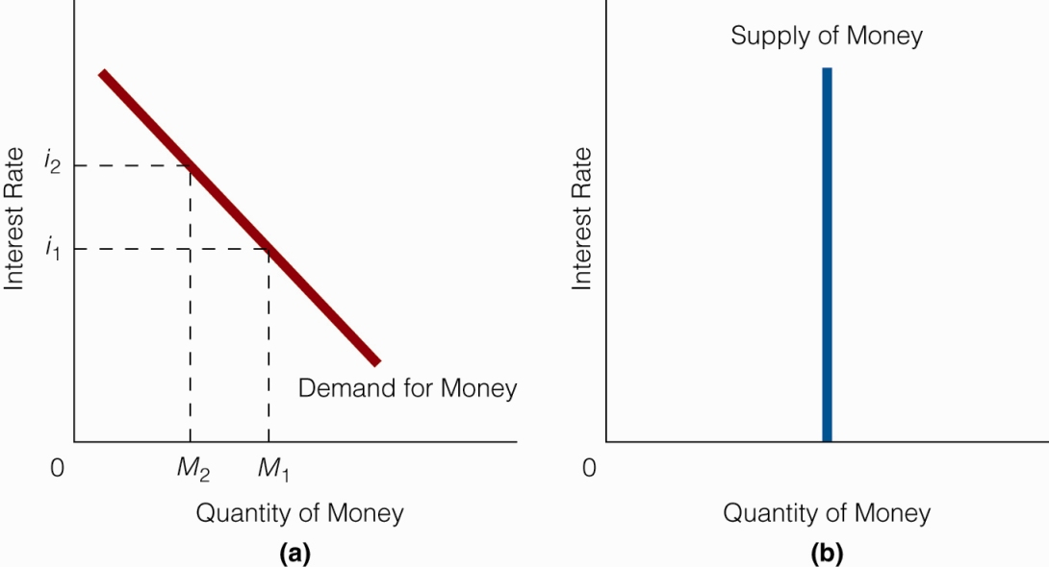
Demand for Money
Represents the inverse relationship between the quantity demanded of money balances and the price of holding money balances.
Interest rate is the price (opportunity cost) of holding money balances.
Click to return to “In this Lesson”
© 2014 Cengage Learning. All Rights Reserved. May not be copied, scanned, or duplicated, in whole or in part, except for use as permitted in a license distributed with certain product , service, or otherwise on password-protected website for classroom use

Slide 6
The Supply of Money
The supply curve of money is a vertical line at the quantity of money, which is largely, but not exclusively, determined by the Fed.
Click to return to “In this Lesson”
© 2014 Cengage Learning. All Rights Reserved. May not be copied, scanned, or duplicated, in whole or in part, except for use as permitted in a license distributed with certain product , service, or otherwise on password-protected website for classroom use

Slide 7
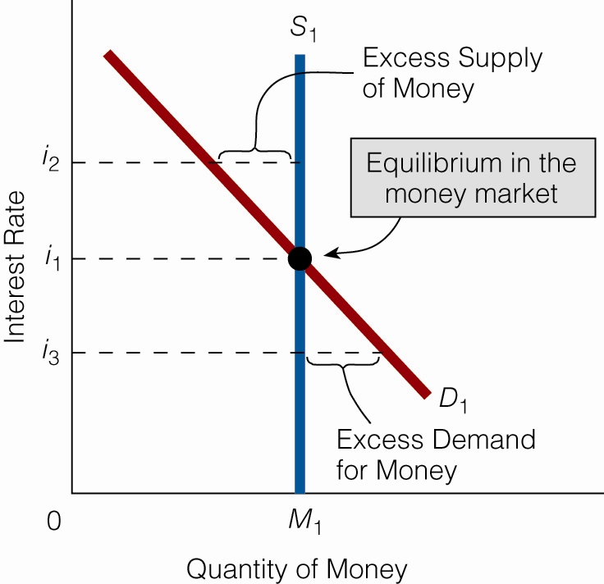
Equilibrium in the Money Market
At an interest rate of i₁, the money market is in equilibrium: There is neither an excess supply of money nor an excess demand for money
Click to return to “In this Lesson”
© 2014 Cengage Learning. All Rights Reserved. May not be copied, scanned, or duplicated, in whole or in part, except for use as permitted in a license distributed with certain product , service, or otherwise on password-protected website for classroom use

Slide 8

Keynesian Transmission Mechanism
For a tutorial on the Keynesian Transmission Mechanism click photo.
John Maynard Keynes
Click to return to “In this Lesson”
© 2014 Cengage Learning. All Rights Reserved. May not be copied, scanned, or duplicated, in whole or in part, except for use as permitted in a license distributed with certain product , service, or otherwise on password-protected website for classroom use

Slide 9
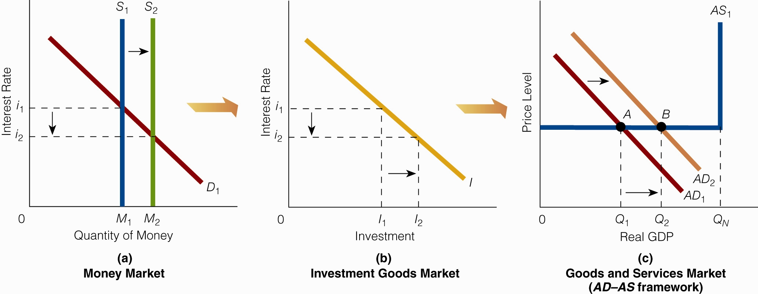
Keynesian Transmission Mechanism
(a) An increase in the money supply brings on a lower interest rate.
(b) As a result, investment increases.
(c) As investment increases, total expenditures rise and the aggregate demand curve shifts rightward. Real GDP rises from Q1 to Q2.
Click to return to “In this Lesson”
© 2014 Cengage Learning. All Rights Reserved. May not be copied, scanned, or duplicated, in whole or in part, except for use as permitted in a license distributed with certain product , service, or otherwise on password-protected website for classroom use

Slide 10
Keynesian Mechanism May Get Blocked
The Keynesian transmission mechanism allows the link between the money market and the goods and services market to be broken in two places if:
  Investment is totally interest-insensitive, and
  The money market is in the liquidity trap
Click to return to “In this Lesson”
© 2014 Cengage Learning. All Rights Reserved. May not be copied, scanned, or duplicated, in whole or in part, except for use as permitted in a license distributed with certain product , service, or otherwise on password-protected website for classroom use

Slide 11
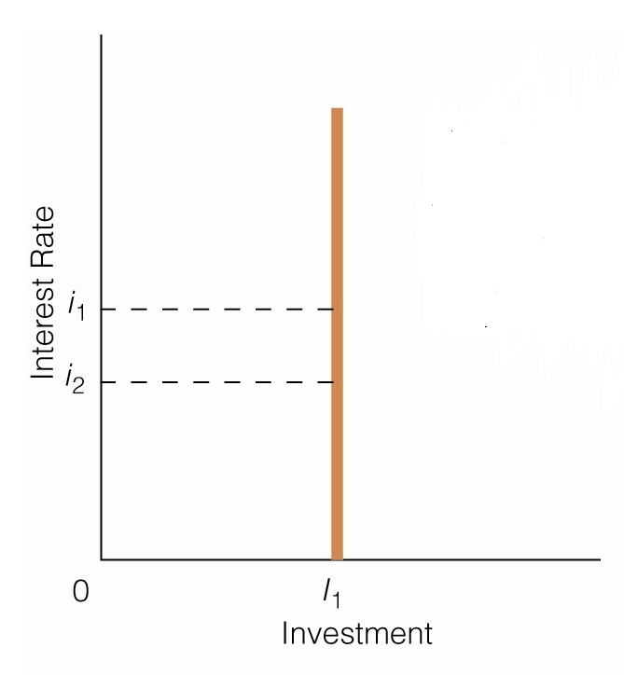
Keynesian Mechanism May Get Blocked – Interest Insensitive Investment
If investment is totally interest-insensitive, a change in the interest rate will not change investment; therefore, aggregate demand and Real GDP will not change.
Click to return to “In this Lesson”
© 2014 Cengage Learning. All Rights Reserved. May not be copied, scanned, or duplicated, in whole or in part, except for use as permitted in a license distributed with certain product , service, or otherwise on password-protected website for classroom use

Slide 12
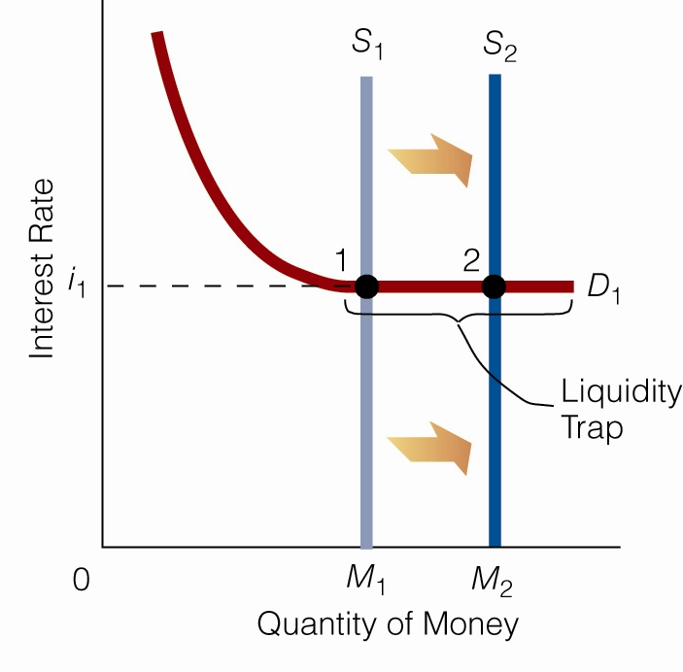
Keynesian Mechanism May Get Blocked – Liquidity Trap
Liquidity Trap - The horizontal portion of the demand curve for money.
If the money market is in the liquidity trap, an increase in the money supply will not lower the interest rate.
It follows that there will be no change in investment, aggregate demand or Real GDP.
Click to return to “In this Lesson”
© 2014 Cengage Learning. All Rights Reserved. May not be copied, scanned, or duplicated, in whole or in part, except for use as permitted in a license distributed with certain product , service, or otherwise on password-protected website for classroom use

Slide 13
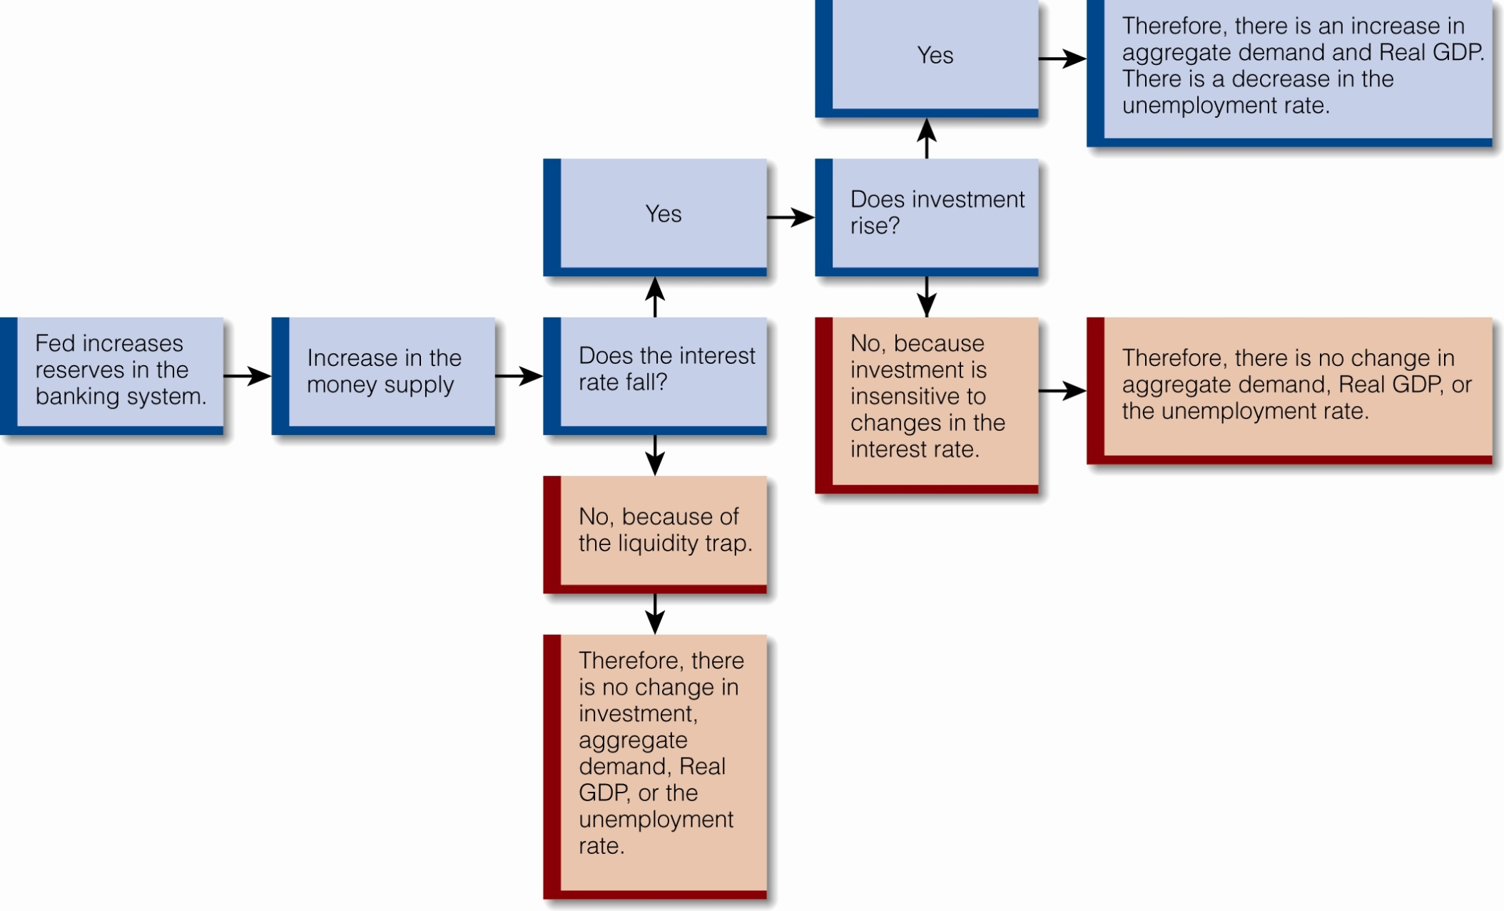
The Keynesian View of Monetary Policy
Click to return to “In this Lesson”
© 2014 Cengage Learning. All Rights Reserved. May not be copied, scanned, or duplicated, in whole or in part, except for use as permitted in a license distributed with certain product , service, or otherwise on password-protected website for classroom use

Slide 14
The Monetarist Transmission
Mechanism – Short & Direct
Changes in the money market directly affect aggregate demand in the goods and services market.
For example, an increase in the money supply leaves individuals with an excess supply of money that they spend on a wide variety of goods.
M1 ↑ → ↑ AD
Click to return to “In this Lesson”
© 2014 Cengage Learning. All Rights Reserved. May not be copied, scanned, or duplicated, in whole or in part, except for use as permitted in a license distributed with certain product , service, or otherwise on password-protected website for classroom use

Slide 15
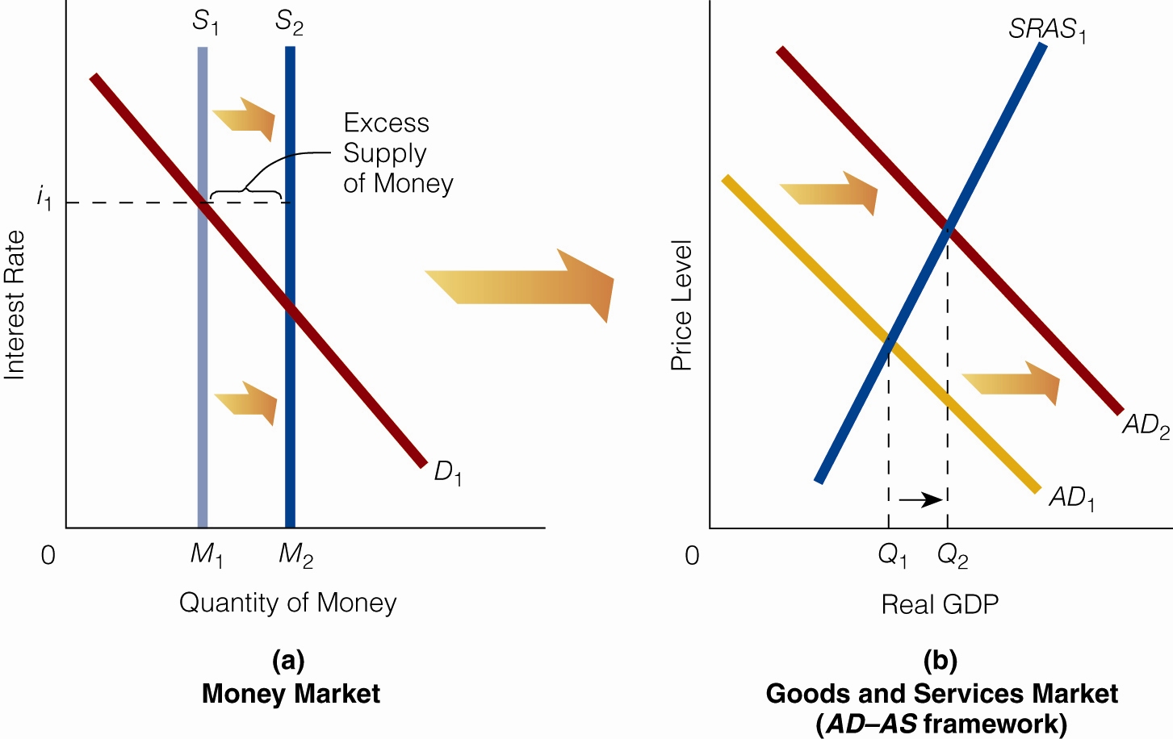
The Monetarist Transmission
Mechanism
Click to return to “In this Lesson”
© 2014 Cengage Learning. All Rights Reserved. May not be copied, scanned, or duplicated, in whole or in part, except for use as permitted in a license distributed with certain product , service, or otherwise on password-protected website for classroom use

Slide 16
Self-test
1. Explain the inverse relationship between bond prices and interest rates.
Kahn buys a bond for a face value of $10,000 that promises to pay a 10 percent interest rate each year for 10 years. In one year, though, bonds are offered for a face value of $10,000 that pay an 11 percent interest rate each year for 10 years. If Kahn wants to sell his bond, he won’t be able to sell it for $10,000 because no one today will pay $10,000 for a bond that pays a 10 percent interest rate when a $10,000, 11 percent bond is available. Kahn has to lower the price of his bond if he wants to sell it. Thus, as interest rates rise, bond prices decrease (for old or existing bonds).
Click to return to “In this Lesson”
© 2014 Cengage Learning. All Rights Reserved. May not be copied, scanned, or duplicated, in whole or in part, except for use as permitted in a license distributed with certain product , service, or otherwise on password-protected website for classroom use

Slide 17
Self-test
2. “According to the Keynesian transmission mechanism, as the money supply rises, there is a direct impact on the goods and services market.” Do you agree or disagree with this statement? Explain your answer.
We disagree for two reasons. First, if the money market is in the liquidity trap, a rise in the money supply will not affect interest rates and therefore will not affect investment or the goods and services market. market can affect the goods and services market only indirectly.
(continued)
Click to return to “In this Lesson”
© 2014 Cengage Learning. All Rights Reserved. May not be copied, scanned, or duplicated, in whole or in part, except for use as permitted in a license distributed with certain product , service, or otherwise on password-protected website for classroom use

Slide 18
Self-test
Second, even if the money market is not in the liquidity trap, a rise in the money supply affects the goods and services market not directly, but indirectly: The rise in the money supply lowers the interest rate, causing investment to rise (assuming investment is not interest insensitive). As investment rises, the AD curve shifts rightward, affecting the goods and services market. In other words, there is an important intermediate market between the money market and the goods and services market in the Keynesian transmission mechanism. Thus, the money market can affect the goods and services market only indirectly.
Click to return to “In this Lesson”
© 2014 Cengage Learning. All Rights Reserved. May not be copied, scanned, or duplicated, in whole or in part, except for use as permitted in a license distributed with certain product , service, or otherwise on password-protected website for classroom use

Slide 19
Self-test
3. Explain how the monetarist transmission mechanism works when the money supply rises.
A rise in the money supply brings about an excess supply of money in the money market that flows to the goods and services market, stimulating aggregate demand.
Click to return to “In this Lesson”
© 2014 Cengage Learning. All Rights Reserved. May not be copied, scanned, or duplicated, in whole or in part, except for use as permitted in a license distributed with certain product , service, or otherwise on password-protected website for classroom use

Slide 20
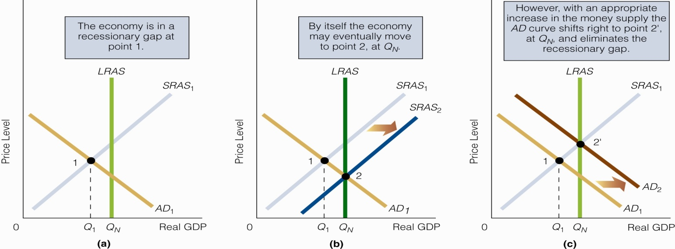
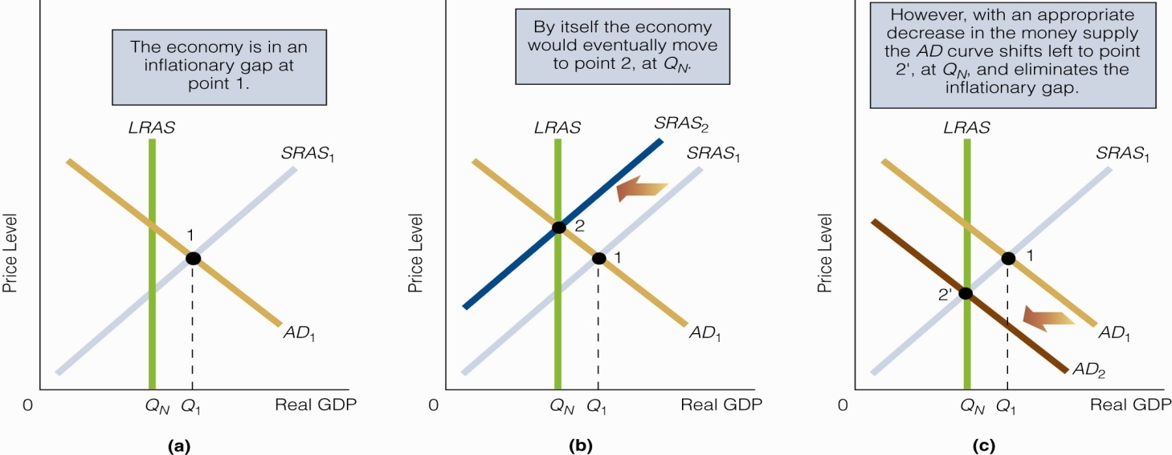
Monetary Policy
Expansionary - The Fed increases the money supply to address a recessionary gap.
Contractionary - The Fed decreases the money supply to address an inflationary gap
Click to return to “In this Lesson”
© 2014 Cengage Learning. All Rights Reserved. May not be copied, scanned, or duplicated, in whole or in part, except for use as permitted in a license distributed with certain product , service, or otherwise on password-protected website for classroom use

Slide 21

Monetary Policy and a Recessionary Gap
Click to return to “In this Lesson”
© 2014 Cengage Learning. All Rights Reserved. May not be copied, scanned, or duplicated, in whole or in part, except for use as permitted in a license distributed with certain product , service, or otherwise on password-protected website for classroom use

Slide 22
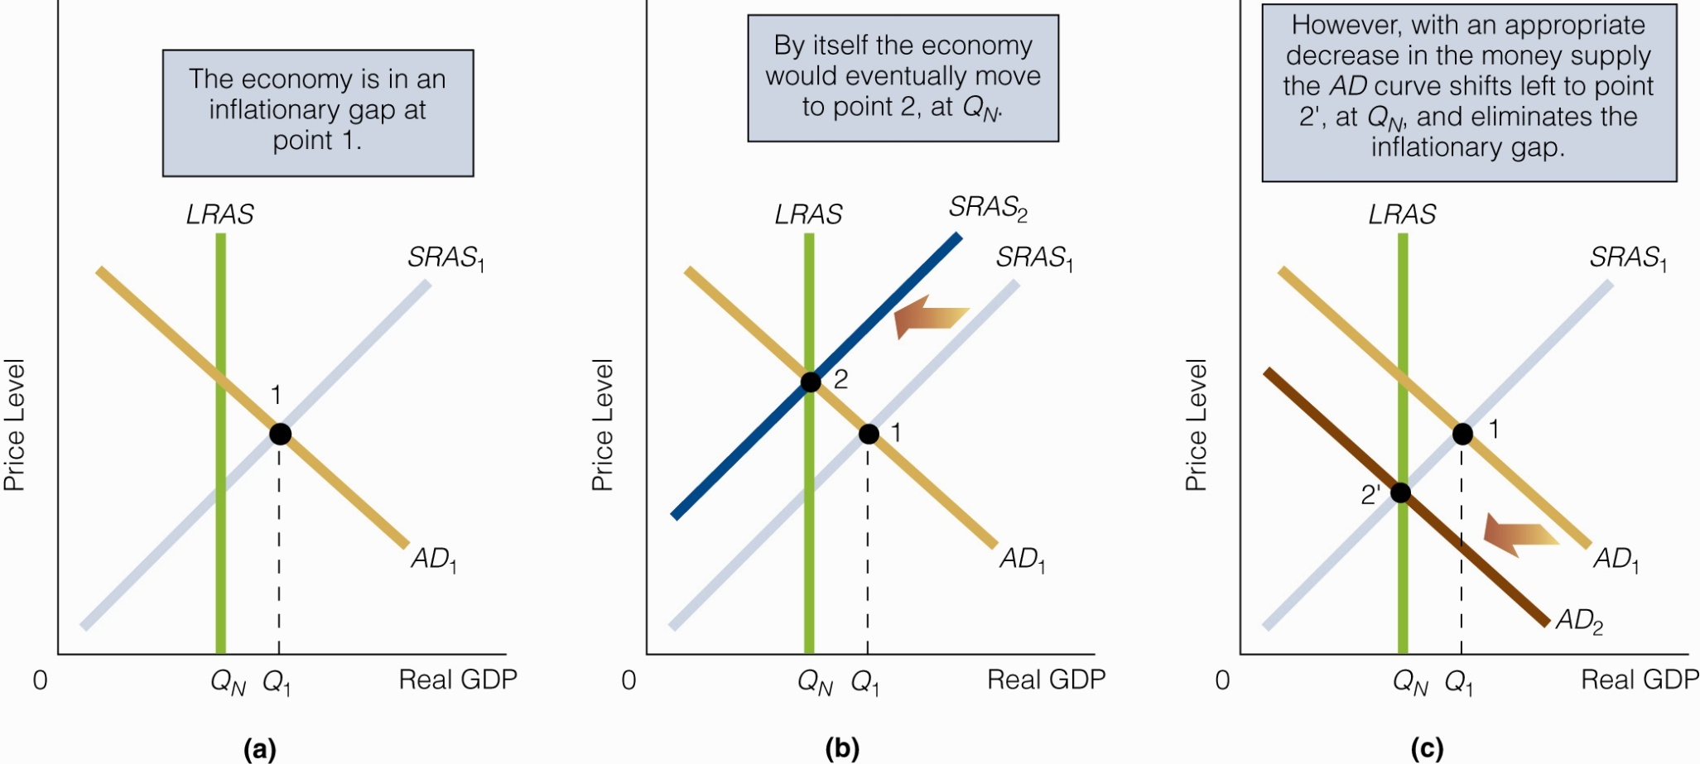
Monetary Policy and an Inflationary Gap
Click to return to “In this Lesson”
© 2014 Cengage Learning. All Rights Reserved. May not be copied, scanned, or duplicated, in whole or in part, except for use as permitted in a license distributed with certain product , service, or otherwise on password-protected website for classroom use

Slide 23

Bond Prices, Interest Rates, and the Liquidity Trap
The liquidity trap, or the horizontal section of the demand curve for money, seems to come out of the clear blue sky. Why might the demand curve for money become horizontal at some low interest rate? To understand the explanation, you must first understand the relationship between bond prices and interest rates.
For a basic understanding of bonds, click the photo
Click to return to “In this Lesson”
© 2014 Cengage Learning. All Rights Reserved. May not be copied, scanned, or duplicated, in whole or in part, except for use as permitted in a license distributed with certain product , service, or otherwise on password-protected website for classroom use

Slide 24
Bond Prices, Interest Rates, and the Liquidity Trap
The market interest rate is inversely related to the price of old or existing bonds. As interest rates rise, he price of a an already issued (old) bond decreases and vice-versa.
At a low interest rate, the money supply increases but does not result in an excess supply of money. Interest rates are very low, and so bond prices are very high. Would-be buyers believe that bond prices are so high that they have no place to go but down. So individuals would rather hold all the additional money supply than use it to buy bonds.
Click to return to “In this Lesson”
© 2014 Cengage Learning. All Rights Reserved. May not be copied, scanned, or duplicated, in whole or in part, except for use as permitted in a license distributed with certain product , service, or otherwise on password-protected website for classroom use

Slide 25
Activists & Fine-tuning
Activists - Persons who argue that monetary and fiscal policies should be deliberately used to smooth out the business cycle.
Fine Tuning - The (usually frequent) use of monetary and fiscal policies to counteract even small undesirable movements in economic activity.
Click to return to “In this Lesson”
© 2014 Cengage Learning. All Rights Reserved. May not be copied, scanned, or duplicated, in whole or in part, except for use as permitted in a license distributed with certain product , service, or otherwise on password-protected website for classroom use

Slide 26
The Case for Activist
Monetary Policy
The economy does not always equilibrate quickly enough at Natural Real GDP.
Activist monetary policy works; it is effective at smoothing out the business cycle.
Activist monetary policy is flexible; non-activist (rules-based) monetary policy is not.
Click to return to “In this Lesson”
© 2014 Cengage Learning. All Rights Reserved. May not be copied, scanned, or duplicated, in whole or in part, except for use as permitted in a license distributed with certain product , service, or otherwise on password-protected website for classroom use

Slide 27

Non-activists
Persons who argue against the deliberate use of discretionary fiscal and monetary policies.
They believe in a permanent, stable, rule-oriented monetary and fiscal framework.
Click to return to “In this Lesson”
© 2014 Cengage Learning. All Rights Reserved. May not be copied, scanned, or duplicated, in whole or in part, except for use as permitted in a license distributed with certain product , service, or otherwise on password-protected website for classroom use

Slide 28
The Case for Non-activist Monetary Policy
In modern economies, wages and prices are sufficiently flexible to allow the economy to equilibrate at reasonable speed at Natural Real GDP.
Activist monetary policies may not work.
Activist monetary policies are likely to be destabilizing rather than stabilizing; they are likely to make matters worse rather than better.
Click to return to “In this Lesson”
© 2014 Cengage Learning. All Rights Reserved. May not be copied, scanned, or duplicated, in whole or in part, except for use as permitted in a license distributed with certain product , service, or otherwise on password-protected website for classroom use

Slide 29
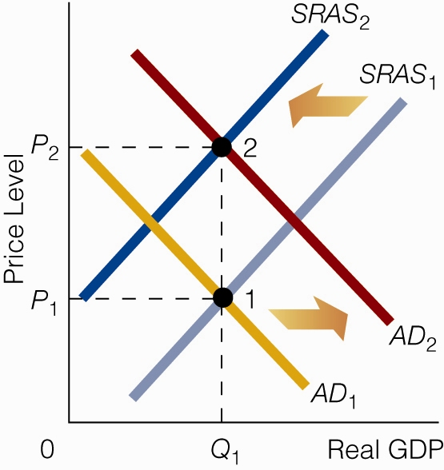
Expansionary Monetary Policy and No Change in Real GDP
If expansionary monetary policy is anticipated (thus, a higher price level is anticipated), workers may bargain for and receive higher wage rates.
It is possible that the SRAS curve will shift leftward to the same degree that expansionary monetary policy shifts the AD curve rightward.
Result: No change in Real GDP.
Click to return to “In this Lesson”
© 2014 Cengage Learning. All Rights Reserved. May not be copied, scanned, or duplicated, in whole or in part, except for use as permitted in a license distributed with certain product , service, or otherwise on password-protected website for classroom use

Slide 30
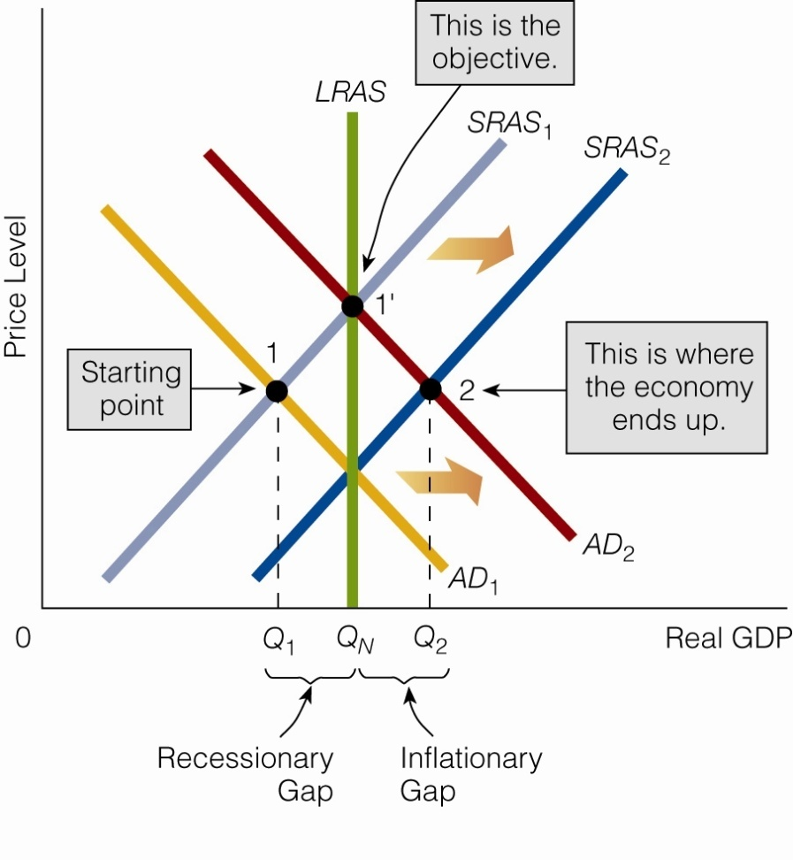
Monetary Policy May Destabilize the Economy
The SRAS curve is shifting rightward (ridding the economy of its recessionary gap), but Fed officials do not realize this is happening.
They implement expansionary monetary policy, and the AD curve ends up intersecting SRAS₂ at point 2 instead of intersecting SRAS₁ at point 1'.
Fed officials end up moving the economy into an inflationary gap and thus destabilizing the economy.
Click to return to “In this Lesson”
© 2014 Cengage Learning. All Rights Reserved. May not be copied, scanned, or duplicated, in whole or in part, except for use as permitted in a license distributed with certain product , service, or otherwise on password-protected website for classroom use

Slide 31
Self-test
Why are Keynesians more likely to advocate expansionary monetary policy to eliminate a recessionary gap than contractionary monetary policy to eliminate an inflationary gap?
Keynesians believe that prices and wages are inflexible downward but not upward. They believe it is more likely that natural forces will move an economy out of an inflationary gap than out of a recessionary gap.
Click to return to “In this Lesson”
© 2014 Cengage Learning. All Rights Reserved. May not be copied, scanned, or duplicated, in whole or in part, except for use as permitted in a license distributed with certain product , service, or otherwise on password-protected website for classroom use

Slide 32
Self-test
2. How might monetary policy destabilize the economy?
Suppose the economy is regulating itself out of a recessionary gap, but this is not known to Fed officials. Thinking that the economy is stuck in a recessionary gap, the Fed increases the money supply. When the money supply is felt in the goods and services market, the AD curve intersects the SRAS curve (that has been moving rightward, unbeknownst to officials) at a point that represents an inflationary gap. In other words, the Fed has moved the economy from a recessionary gap to an inflationary gap instead of from a recessionary gap to long-run equilibrium at the Natural Real GDP level.
Click to return to “In this Lesson”
© 2014 Cengage Learning. All Rights Reserved. May not be copied, scanned, or duplicated, in whole or in part, except for use as permitted in a license distributed with certain product , service, or otherwise on password-protected website for classroom use

Slide 33
Self-test
3. If the economy is stuck in a recessionary gap, does this make the case for activist (expansionary) monetary policy stronger or weaker? Explain your answer.
Being stuck in a recessionary gap makes the case stronger, ceteris paribus. If the economy can’t get itself out of a recessionary gap, then the case is stronger for the Fed to take action. However, this is not to say that expansionary monetary policy will work ideally. There may still be problems with the correct implementation of the policy.
Click to return to “In this Lesson”
© 2014 Cengage Learning. All Rights Reserved. May not be copied, scanned, or duplicated, in whole or in part, except for use as permitted in a license distributed with certain product , service, or otherwise on password-protected website for classroom use

Slide 34
Non-activist Monetary Proposals Constant-Money-Growth-Rate Rule
One version of the rule is: The annual money supply growth rate will be constant at the average annual growth rate of Real GDP.
Critics of the constant-money-growth-rate rule point out that it makes two assumptions: (1) Velocity is constant. (2) The money supply is defined correctly.
However, there have been periods when velocity has not been constant. And it is not clear which definition of the money supply (M1, M2, or some broader monetary measure) is the proper one to use.
Click to return to “In this Lesson”
© 2014 Cengage Learning. All Rights Reserved. May not be copied, scanned, or duplicated, in whole or in part, except for use as permitted in a license distributed with certain product , service, or otherwise on password-protected website for classroom use

Slide 35
Non-activist Monetary Proposals
A Predetermined-Money-Growth-Rate Rule
Largely in response to the charge that velocity is not always constant, some non-activists prefer the following rule:
The annual growth rate in the money supply will be equal to the average annual growth rate in Real GDP minus the growth rate in velocity.
%ΔM = %ΔQ – %ΔV
Click to return to “In this Lesson”
© 2014 Cengage Learning. All Rights Reserved. May not be copied, scanned, or duplicated, in whole or in part, except for use as permitted in a license distributed with certain product , service, or otherwise on password-protected website for classroom use

Slide 36
Taylor Rule – A Middle Ground
Federal funds rate target = 1.5 (inflation rate) + 0.5 (GDP gap) + 1
Inflation rate- This is the current inflation rate.
1⁄2 output gap - The output gap is the percentage difference between actual Real GDP and its full-employment or natural level.
Click to return to “In this Lesson”
© 2014 Cengage Learning. All Rights Reserved. May not be copied, scanned, or duplicated, in whole or in part, except for use as permitted in a license distributed with certain product , service, or otherwise on password-protected website for classroom use

Slide 37
Inflation Targeting
This requires the Fed to try to keep the inflation rate near a predetermined level.
Major issues:
A specific Rate or range?
If so, what range or rate?
Announce rate or not?
Click to return to “In this Lesson”
© 2014 Cengage Learning. All Rights Reserved. May not be copied, scanned, or duplicated, in whole or in part, except for use as permitted in a license distributed with certain product , service, or otherwise on password-protected website for classroom use

Slide 38
Self-test
Would a rules-based monetary policy produce price stability?
The answer to this open-ended question depends on many factors. First, the answer depends on what the rule specifies because not all rules are alike. Second, it depends on the stability and predictability of velocity.
(continued)
Click to return to “In this Lesson”
© 2014 Cengage Learning. All Rights Reserved. May not be copied, scanned, or duplicated, in whole or in part, except for use as permitted in a license distributed with certain product , service, or otherwise on password-protected website for classroom use

Slide 39
Self-test
For example, suppose the rule specifies that each year the money supply will rise by the average annual growth rate in Real GDP. If velocity is constant, this kind of rise will produce price stability. But if velocity is extremely volatile, changes in it might offset changes in the money supply, leading to deflation instead of price stability. For example, suppose Real GDP rises by 3 percent and the money supply increases by 3 percent, but velocity decreases by 3 percent. The change in velocity offsets the change in the money supply, leaving a net effect of a 3 percent rise in Real GDP. This, then, would lead to a 3 percent decline in the price level.
Click to return to “In this Lesson”
© 2014 Cengage Learning. All Rights Reserved. May not be copied, scanned, or duplicated, in whole or in part, except for use as permitted in a license distributed with certain product , service, or otherwise on password-protected website for classroom use

Slide 40
Self-test
2. Suppose the inflation rate is 4 percent and the GDP gap is 5 percent. What is the Taylor rule recommendation for the federal funds rate target?
Here is the Taylor rule specification:
Federal funds rate target = 1.5 (4 percent) +0.5 (5 percent) + 1 = 9.5 percent.
Click to return to “In this Lesson”
© 2014 Cengage Learning. All Rights Reserved. May not be copied, scanned, or duplicated, in whole or in part, except for use as permitted in a license distributed with certain product , service, or otherwise on password-protected website for classroom use

Slide 41

Wall Street Journal
The Wall Street Journal is a is a rich source of information which provides real life examples of micro- and macro economic activities. Check today’s issue to see the most current news.
http://www.wsj.com
Click to return to “In this Lesson”
© 2014 Cengage Learning. All Rights Reserved. May not be copied, scanned, or duplicated, in whole or in part, except for use as permitted in a license distributed with certain product , service, or otherwise on password-protected website for classroom use

